Slide 1

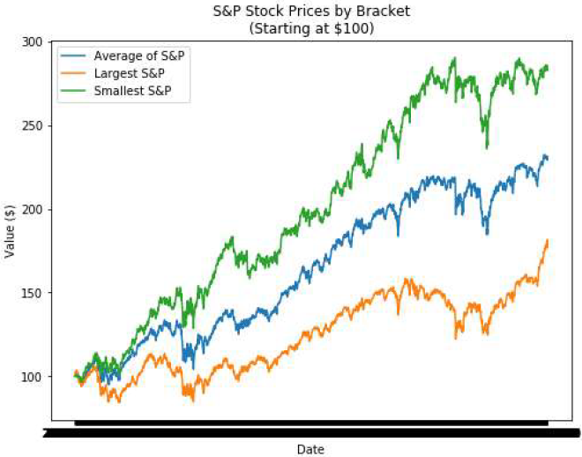
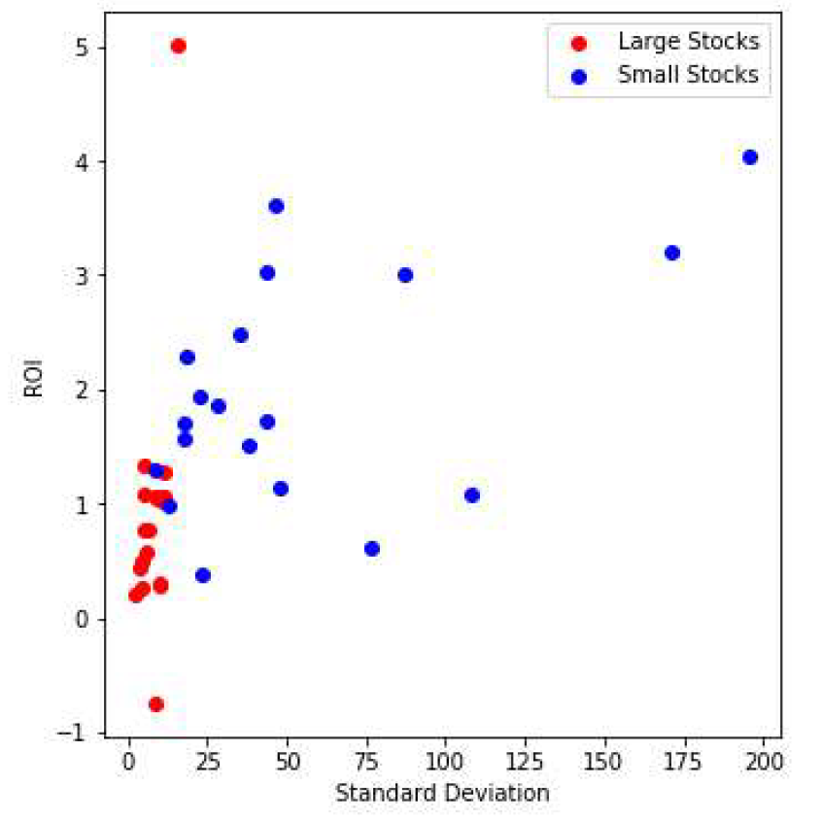
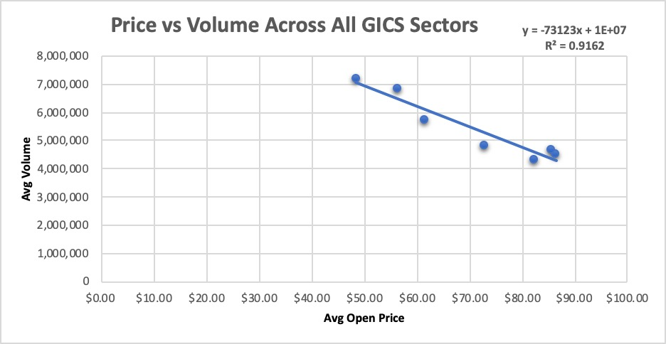
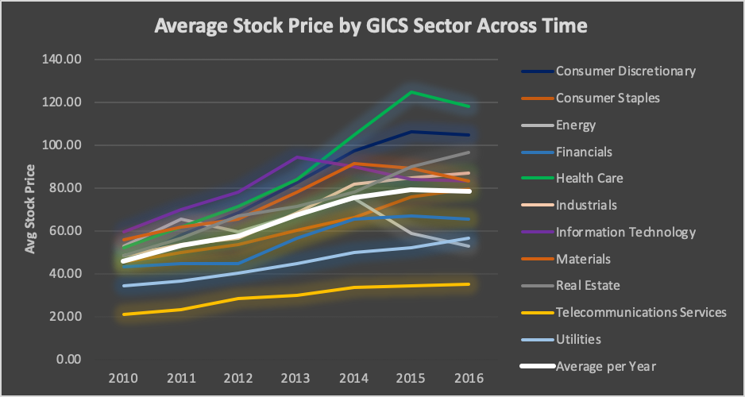
Exploratory Data Analysis on NYSE Data Using Data Mining Techniques
IS733 Data Mining | Poster Presentation
Abhishek Mahindrakar, Joseph Knapp, Kamlesh Pai, Kushagra Verma, Syed Nasir
University of Maryland , Baltimore County
Overview
RESULTS
We use data mining techniques to perform an exploratory data analysis on the stock market data for the S&P 500 companies on the New York Stock Exchange, the world’s largest stock exchange by market capitalization (Wee, 2017). The goal is to identify those GICS sectors whose stocks have generated the highest return on investments over the past couple of years in order to help investors quickly identify the most profitable company stocks for their stock portfolios. Moreover, we explored the relationships that exist between various factors (e.g. stock volume and stock price, GICS sector and ROI, GICS sector and risk, etc.) in order to gather meaningful insights into those factors that may influence the return on investments for a company’s stocks. Our motivation is to empower the investor community with additional insights that may help them make informed investment decisions.
The linear regression model (Figure 1) reveals an inverse relationship between the average stock volume and the average stock price across all the GICS sectors indicating that as the stock prices go up, stock volume tends to go down. This finding is consistent with our time series analysis (Figure 3) which indicates that the prices of the smallest stocks are consistently higher compared to the prices from the largest stocks. The average return for the 386 companies over the seven years was 142.34%. Similarly, the average returns for the small and large stocks were 197.03% and 91.38% respectively. The smallest stocks appear to greatly outperform the largest stocks as well as the average of the stock index. Our scatter plot (Figure 4) illustrates that as the standard deviation (or risk) increases, ROI tends to increase as well. The results from our OLS regression analysis indicate that as volume increases, ROI decreases. However, unlike the linear regression model that had an R² of 0.91, the OLS regression model has a very poor R² statistic of 0.22 meaning only 22% of the variance is explained by the model.
Figure 3: Stock price comparison by stock brackets starting at $100.
Figure 4: Scatter plot compares ROI with standard deviation for large and small stocks.
Data Preprocessing
We performed an exploratory data analysis on the S&P 500 Companies using a New York Stock Exchange (NYSE) dataset that we acquired from the public domain. The dataset was available in a comma-separated values (CSV) file, contained over 850 thousand records, and covered a timespan of seven years ranging from Jan 2010 through Dec 2016. We calculated new attributes and appended additional columns to our original dataset and mapped the company name, GICS sector, GICS sub industry information from the supplementary dataset to our NYSE dataset using a VLOOKUP table in excel. Moreover, we graphed the stocks for several companies and noticed that there were a couple of stocks whose prices spiked or dropped abnormally; this helped us realize that the stock prices in our NYSE dataset were not adjusted for stock splits (which affects ROI and standard deviations). As such, we decided to ignore any companies that contained stock splits (as well as those companies that had missing data) from our time-series and ordinary least square (OLS) regression analyses; this reduced the number of companies from 501 to 386.
Table 1: Open stock price statistics by GICS sector.
Conclusion
The linear regression model revealed an inverse relationship between the stock volume and the stock price across all the GICS sectors indicating that as the stock price goes up, stock volume tends to go down. Similarly, our time series analysis indicated that the prices of the smallest stocks are consistently higher compared to the prices of the largest stocks, and that the smallest stocks appear to greatly outperform the largest stocks as well as the average of the stock index. Whereas the stock prices for the health care sector is typically the highest, the stock prices for the telecommunications sector is consistently the lowest. Likewise, consumer discretionary and information technology sectors seemingly have the greatest variance in stock price. Our scatter plot illustrates that as the standard deviation (or risk) increases, ROI tends to increase as well. Lastly, the results from our OLS regression analysis indicate that as stock volume increases, ROI decreases; but this model was poor and cannot be relied upon given the low R² statistic. We noticed that stock split scenarios influence the calculations of ROI and standard deviations with the magnitude of the impact currently unknown; this can be an area of interest for future research.
Methods
Figure 1: Linear regression measures the relationship between the average stock volume and the average stock price across all the GICS sectors.
According to the National Institute of Standards and Technology (NIST), “exploratory data analysis (EDA) is an approach/philosophy for data analysis that employs a variety of techniques (mostly graphical) to maximize insight into a data set, uncover underlying structure, extract important variables, detect outliers and anomalies, and test underlying assumptions” (NIST, 2013). With this in mind, the primary data mining techniques we use include linear regression, ordinary least square (OLS) regression, and time-series prediction. We also generate summary statistics and perform scatter plots and time-series analysis. The linear regression model measures the relationship between the average volume and the average stock price across all the GICS sectors where each coordinate pair represents the averages for the entire year. We identify those GICS sectors whose stocks have the greatest variance (meaning price fluctuations) across time in order to determine whether certain sectors of the economy are riskier to invest in compared to others (e.g. real estate vs health care).
REFEREnces
Gawlik, D. (2017). New York Stock Exchange: S&P 500 companies historical prices with fundamental data. Retrieved from https://www.kaggle.com/dgawlik/nyse/
In‑text: (Gawlik, 2017)
Macroption. (2019). Number of trading days per year. Retrieved from https://www.macroption.com/trading-days-per-year/
In‑text: (Macroption, 2019)
NIST. (2013). NIST/SEMATECH e-Handbook of Statistical Methods. Retrieved from https://www.itl.nist.gov/div898/handbook/eda/section1/eda11.htm
In‑text: (NIST, 2013)
Wee, R. Y. (2017, April 25). Biggest stock exchanges in the world. Retrieved from https://www.worldatlas.com/articles/biggest-stock-exchanges-in-the-world.html
In‑text: (Wee, 2017)
Figure 2: Average stock price per year by GICS sector.
INFORMATION SYSTEMS, UNIVERSITY OF MARYLAND BALTIMORE COUNTY

